Slide 1
Working with ELM
Module 11

Slide 2
Module Objectives
Upon completion of this module, you will be able to:
Perform the initial setup and configuration of an ELM device.
Perform the initial setup and configuration of Storage Pools.
Calculate the required storage space required to meet retention requirements.
Perform ELM data searches using the ELM Data search feature.
Perform ELM integrity checks using the ELM integrity check feature.
Perform enhanced searching using the Enhanced ELM Search View.

Slide 3

Module Topics
ELM Properties
ELM Terminology
Adding a ELM Device
Estimating ELM Storage
Configuring ELM and Storage Pools
ELM Compression
ELM Data Searching
ELM Integrity Checking
Enhanced ELM Search

Slide 4
ELM Properties
The Enterprise Log Manager (ELM) provides features and capabilities to support the storage and management of, access to, and reporting of log data.
The data received by the ELM are organized in storage pools, each composed of storage devices.
A retention time is associated with each storage pool and the data is retained in the pool for the period of time specified. This is particularly useful because various government, industry, and corporate regulations require that logs be stored for different periods of time.
The ELM provides the capability to setup search, export, and integrity check jobs. Each of these jobs will access the stored logs and retrieve, export, or check the data that you define in the job. You can then view the results and choose to save the information.
Warning
ELM is not FIPS compliant. If you are required to comply with FIPS regulations, it is recommended that you not use this feature.

Slide 5
ELM Terminology
Storage Device – A data storage device accessible to an ELM. Some ELM models offer an on-board storage device, some a SAN connection capability, and some both. All ELM models offer a NAS connection capability.
Storage Allocation – A specific amount of data storage on a specific storage device (e.g., 1TB on a NAS storage device).
Data Retention Time – The amount of time a log is stored.
Storage Pool – One or more storage allocations, which together specify a total amount of storage, coupled with a data retention time that specifies the maximum number of days a log is to be stored.
Log Source – Any source of logs that an ELM stores.

Slide 6
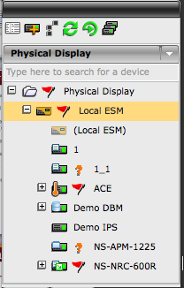
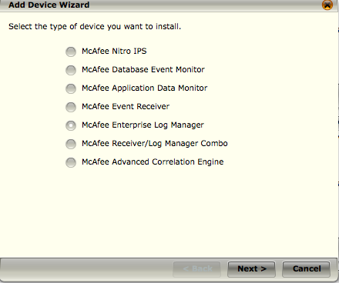
Add ELM device
NOTE
The ELM is only available if your ESM is hardware-based (not VMware) and if you have purchased ELM functionality for your ESM.
Notes:
To add an ELM device to your system:
1. Select the Local ESM node on the System Navigation Tree or a group level node for the group to which you wish to add the device.
2. Select the Add Device icon in the Actions Toolbar. The Add Device Wizard will appear.
3. Select Enterprise Log Manager or Receiver/Log Manager Combo.

Slide 7
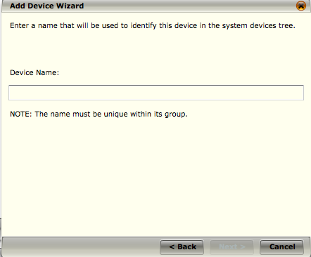
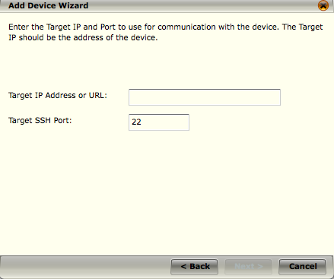
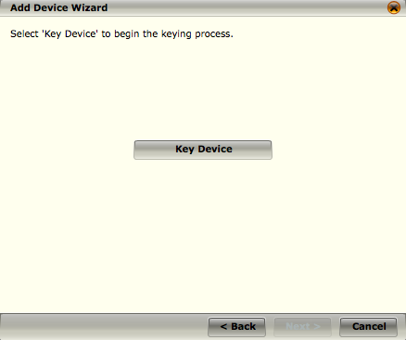
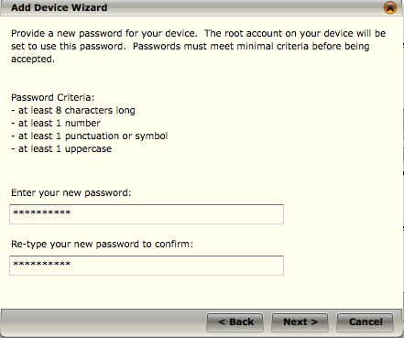
Add ELM Device Cont.
Enter name for ELM device
Enter Target IP address or URL
Select Key Device
Create a password
Notes:
4. Click Next. The second Add Device Wizard dialog will open.
5. Enter a name for the ELM device in the Device Name field and click Next. The third Add Device Wizard dialog will open.
6. Enter a target IP address or URL.
7. Enter a port number that is valid to be used with the specified IP address. The default port is 22.
8. Click Next. The fourth dialog of the Add Device Wizard will open.
9. Click Key Device. The fifth dialog of the Add Device Wizard will open.
10. Enter a password for this device.
11. Click Next.
The ESM will test device communication and report on the status of the connection. You will be able to directly launch the ELM Properties screen upon successfully keying the device.

Slide 8
Estimating ELM Storage
In order to configure an ELM, you must know:
The data sources that will be storing logs on the ELM
The storage pools that will be required and what their required data retention times are
The storage devices that will be required to store enough data to meet the requirements of numbers 1 and 2.
Generally, you will know the data sources that will store logs on the ELM and the storage pools that are required. However, what is generally unknown, is the storage devices that will be needed to store the amount of data required. The best approach to addressing this uncertainty is:
Make a very conservative estimate of the storage requirements.
Configure ELM storage devices to meet the estimated requirements.
Acquire logs on the ELM for a short period of time.
Use the ELM's storage statistics information to modify the storage device configurations to accommodate the actual data storage requirements.

Slide 9
Estimating ELM Storage Example
Consider a very simple example to illustrate these principles. In this example we know the following:
There is a single data source, a firewall named FW.
The logs from FW must be stored for one year.
FW is estimated to generate one log every second.
FW's logs are estimated to be one hundred bytes each, on average.
Knowing the above, you would do the following:
Make a very conservative estimate of the storage requirements.
FW will generate 365 days/year * (24*60*60) logs/day * 100 bytes/log, which is 3,153,600,000 bytes/year, or 3.15 GB per year.
To make the estimate very conservative, assume only ten percent of this value, or 0.3 GB per year.
NOTE
As of version 9.0.0, ELM storage pools require 10% of the allocated space for mirroring overhead. Be sure to take this 10% into account when calculating the required space.

Slide 10
Estimating ELM Storage Example Cont.
Configure the ELM by adding a storage pool, named SP, whose size is 4 GB because 4 GB is the smallest size allowed and it is large enough to hold the estimated 0.3 GB of required storage.
Note that the “Local” storage device, if available on the ELM, may be used for SP, or another storage device that is configured on the ELM.
Configure the FW data source on its Receiver, and enable logging of its logs to the SP storage pool.
Acquire FW logs into SP on the ELM for a few days.
Review the ELM statistics for the SP storage pool by accessing Properties > Receiver/ELM Management View Usage.
As an example, assume that the statistics for the SP storage pool show a monthly rate of 0.5 GB.
Re-estimate the required storage for SP to be 110% of the measured value. So, in this example, 1.1 * 12 * 0.5 GB/month, or 6.6 GB.
Modify the configuration of SP to allow not 4 GB of storage but 8 GB. Note that the allowed storage was modified to 8 GB because 8 GB - 10% = 7 GB, which is the nearest allowed value to 6.6 GB.

Slide 11
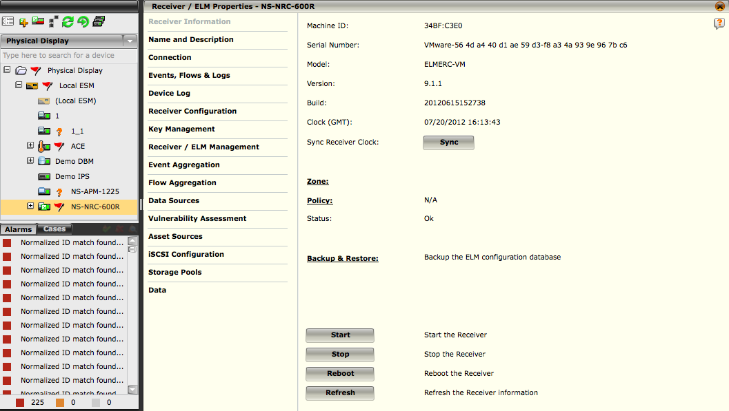
ELM Configuration Settings
Once you have added an ELM device and have defined its storage, there are several settings that need to be configured for the device to run properly.

Slide 12
ELM Information
The ELM Information or Receiver/ELM Information screen shows general information about the selected ELM or Receiver ELM device such as the model, the version of software it is running, and its current status.
It also allows you to perform certain functions on the device. Such as:
Sync – Syncs ELM’s clock with ESM’s clock
FIPS Self Test – Performs a FIPS self test operation
FIPS Identity Token – Identity token used during power-up software integrity testing
Zone – The zone the ELM has been assigned
Status – Displays the status of the ELM process
Backup & Restore – Provides backup and restore options for storage pools and the management database
Start – Starts ELM data collection process
Stop – Stops ELM data collection process
Reboot – Reboot ELM device
Refresh – Reloads information on the ELM information screen
Notes:
Following is a description of the options on this screen:
• Sync - This option syncs the ELM's or Receiver/ELM's clock with the ESM's clock, so that both devices are using the same time.
• FIPS Self Test - If the system is operating in FIPS mode, the ELM Information or Receiver/ELM Information dialog will include the FIPS Self Test button.
• FIPS Identity Token - The value shown below is the identity token used during the power-up software integrity testing required by FIPS 140-2. In order to ensure that the product has not been tampered with, you should compare, on a regular basis, the value shown below to the value displayed in the FIPS Identity Token dialog accessible from the ELM Information or Receiver/ELM Information dialog.
• Zone - Will show the zone to which the device has been assigned if it has been assigned to one.
• Status - This field displays the status of the processes on the ELM or Receiver ELM as well as the FIPS status after running a FIPS self test.
• Backup & Restore - This option allows you to save the current ELM settings, which can be restored in case of system failure or data loss. For details regarding this function, refer to the ELM Backup and Restore section. In addition, it provides a way to restore the data in the storage pools and the management database which has been mirrored should the ELM fail.
• Start - This option starts the ELM's or Receiver ELM's firewall and data source feed collection. This operation has no effect if the ELM or Receiver ELM is already operating normally.
• Stop - This option stops the ELM or Receiver ELM. It does not shut down the device but only halts the collection of data source information. It is recommended that the device not be stopped except in unusual circumstances.
• Reboot - This option allows you to reboot the ELM or Receiver ELM.
• Refresh - The Refresh button will reload all the information displayed on this screen.

Slide 13
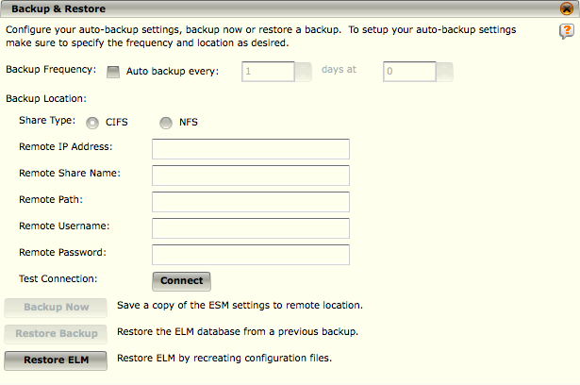
ELM Backup and Restore
Backup & Restore includes all configuration settings, including the ELM logging database.
The Restore Backup button allows you to revert all of your ELM settings and data back to a previous state. If you perform this function, you will lose all changes made to the settings and access to all logs added after the backup was created.
It is highly recommended that you mirror the devices that store the log data on the ELM as well as mirror the ELM management database. The mirroring feature provides real-time data backup.
WARNING
Using CIFS with Samba server versions greater than 3.2 could result in data loss.
Notes:
To automatically backup the ELM settings:
1. Access the ELM Information screen by clicking on the ELM node in the System Navigation Tree and on the Properties icon in the Actions Toolbar.
2. Click on Backup & Restore. The Backup & Restore dialog opens.
3. Click on the Backup Frequency checkbox. The Auto backup every fields will become active.
4. Select the interval at which you want the system to backup the settings in the Auto backup every fields.
a. Select every how many days.
b. Select the hour of the day.
5. Enter the backup location information.
a. Choose the share type to be used: CIFS or NFS.
b. Enter the IP address, share name, path, username, and password for the remote location where the information will be saved.
c. If desired, test the connection by clicking on the Connect button. You will be notified whether the connection is successful or fails.
6. Click on Apply to save this information and keep the Backup & Restore dialog open or OK to save the information and close the dialog. The ELM will automatically backup the settings at the specified interval.
Restore Backup
1. Access the ELM Information screen by clicking on the ELM node in the System Navigation Tree and on the Properties icon in the Actions Toolbar.
2. Click on Backup & Restore. The Backup & Restore dialog opens.
3. Click on the Restore Backup button. The ELM settings will be restored to those in the backup on the system.
You will be notified when the restore has been completed successfully.

Slide 14
Restore ELM
The Restore ELM feature allows you to restore the management database and the ELM log data to a new ELM device should the old device need to be replaced.
In order for this feature to work, the management database and the ELM log data must be mirrored.
WARNING
If you need to restore the data from an old ELM to a new ELM, do NOT create a new ELM using the Add Device Wizard.
Notes:
To restore the management database and the ELM log data to a new ELM if they have not been stored on the ELM or if they have been mirrored, do the following:
1. Click on the ELM that needs to be replaced on the System Navigation Tree.
2. Select the Properties icon on the Actions toolbar. A warning dialog will open letting you know that the system cannot locate the ELM.
3. Close the warning dialog. The ELM Properties dialog will be open.
4. Click on Connection.
5. Enter the IP address for the new ELM in the Target IP Address/Name field. If the IP address for the new ELM is the same as the address for the old ELM, you won't need to change it.
6. Click on Key Management.
7. Click on Key Device. The Key Device Wizard will open.
8. Enter and re-enter the password that you want associated with this device.
9. Click on Next. You will be informed when the new device has been keyed successfully.
10. Click on ELM Information.
11. Click on the Backup & Restore link. The Backup & Restore dialog will open.
12. Click on the Restore ELM button at the bottom of the dialog. The management database and ELM data storage will be restored on the new ELM. This process could take an extended amount of time.

Slide 15
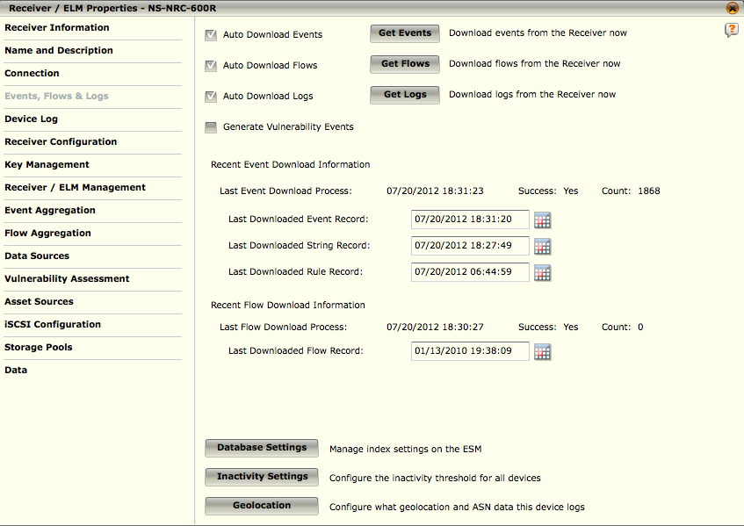
ELM Logs
The Logs option allows you to manually retrieve logs from the ELM, view information about the most recent event retrieval, and set the Last Retrieved date back to retrieve events again.
Checkboxes are also available to enable automatic retrieval of logs.
Notes:
To access the ELM Logs screen, do the following:
1. Highlight the ELM's node on the System Navigation Tree.
2. Click on the Properties icon in the Actions Toolbar. The ELM Properties screen will open.
3. Click on the Logs option. The Logs dialog will open.
Auto Download Logs - If the ESM is set to automatically retrieve logs and this box is checked, this ELM will be added to the list of devices automatically checked for new logs.
Get Logs - The Get Logs option allows you to retrieve logs from the device manually. Click the Get Logs button to retrieve any new logs from the device.

Slide 16
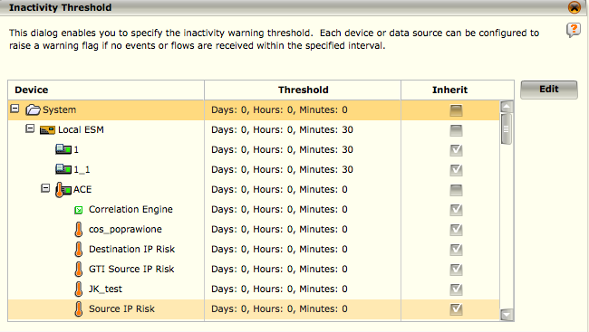
ELM Log – Inactivity Setting
The Inactivity Settings button on the Logs screen allows a master user or system administrator to set the inactivity threshold for any device on the system.
If this threshold is set, the system will generate an alert when the device has not generated logs for the period of time designated.
This alert will show up as a yellow flag next to the device on the System Navigation Tree.
Notes:
To use this feature, do the following:
1.Click on the Inactivity Settings button at the bottom of the ELM Properties > Logs screen. The Inactivity Threshold dialog opens. The default setting for all devices is 0.
2.Highlight the device for which you want to set a threshold and click on Edit. The Edit Inactivity Threshold dialog opens.
3.Set the maximum amount of time that this device can be inactive before generating an alert by clicking on the up or down arrows in the Days, Hours, and/or Minutes fields.
4.Click on OK. You will be returned to the Inactivity Threshold screen. The device will reflect the change in the Threshold column, as will any child of the device that has the Inherit checkbox selected.
5.By default, all devices, data sources, and database servers inherit the threshold set for their parent. If you want to break this inheritance for a specific child:
a. Deselect the checkbox in the Inherit column for the child. The Edit Inactivity Threshold dialog will open.
b. Set the new threshold for the child.
c. Click on OK.
6.Click on OK on the Inactivity Threshold screen to save your settings and return to the Logs screen.

Slide 17
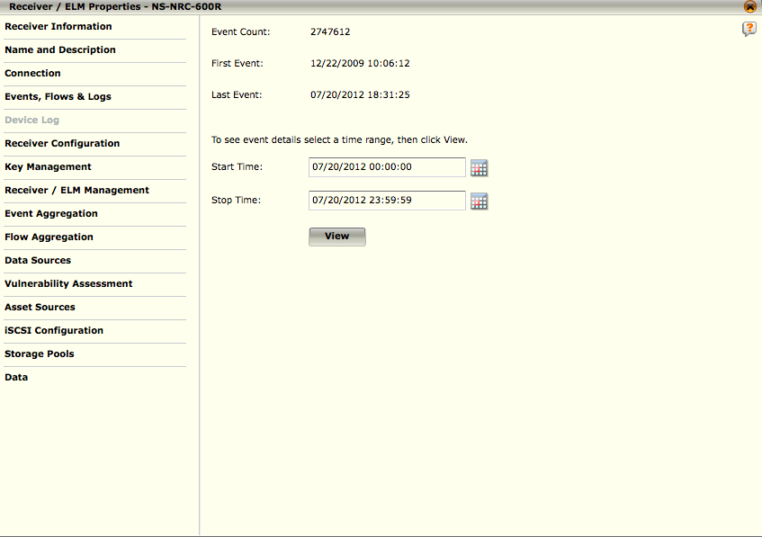
ELM Device Log
The Device Log screen gives a general summary of changes that have been made to the device from the ESMI and status-related events that have occurred on the ELM device.
The Event Count is the total number of events that have been logged on this device.
The First Event is the date and time the first log event took place and the Last Event is the date and time the last log event took place.
Notes:
To access this screen, do the following:
1. Highlight the ELM's node on the System Navigation Tree.
2. Click on the Properties icon in the Actions Toolbar. The ELM Properties dialog will open.
3. Click on the Device Log option on the ELM Properties screen. The Device Log screen will open.
To view events for a specific time range, select the date and time range of the events you wish to view, by typing in the date/time value or selecting one from the calendars, then click the View button. By default, the event log time range is set to show events for the current day. The Device Log dialog will appear, showing a list of all the events that have taken place within the specified time range.

Slide 18
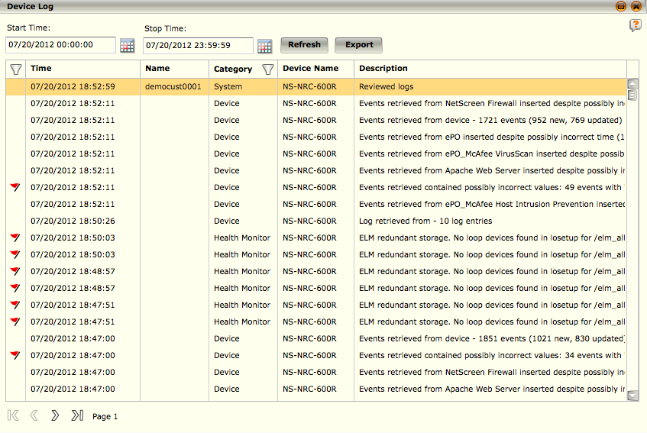
ELM Device Log - View
The ELM Device Log dialog allows you to view details of events that have taken place on the ELM.
The main view will initially be populated with the log events that fall into the time range specified on the Device Log main screen.
To view events over a different time range, select the date and time range of the events you wish to view by typing in the date/time value or selecting one from the calendars, then click the Refresh button.
Notes:
The filter icon in the first column of the table's title bar allows you to select whether you want to view all events, only status-related events, or only non-status events over the time range.
Click on the icon and select Show all, Status, or Non-Status. The table will refresh, containing only the type of events selected.
The filter icon in the category column of the table's title bar allows you to select the categories that you want to view on this table. When you click on the icon the Category Filter dialog opens.
Select or deselect categories by clicking on the checkboxes. Click on OK to refresh the table.
To export events listed in the ELM Device Log to a plain text file, follow the steps below.
1. Click on the Export button. The Export Log dialog appears.
2. Select either the Start Time/Stop Time radio button or the Export All Log Records radio button. If you selected the Start Time/Stop Time radio button, select a specific time range of events to export by clicking on the calendar icons or typing in the date and time in the Start Time and Stop Time fields.
3. To export only status-related log events across the specific date and time range, check the Only Export Status type log records checkbox.
4. If you want the records exported in GMT, select the Export log records in GMT option.
5. Once all settings are as desired, click OK to export the records. The Exporting Log dialog will appear requesting confirmation.
6. To stop the export, click No. To continue with the export, click Yes and the Select location for download dialog will appear.
7. Select the location for the export file to be saved, type in a name for the file, and click Save.

Slide 19
ELM MigrateDB
The ELM management database stores the records that are generated by the ELM.
The amount of disk space that is available on your ELM device to store the management database will depend on the model.
When you first add the device, the system will verify if it has enough disk space to store the records.
If it doesn't, you will, at that time, be prompted to define an alternate location for management database storage.
If the device does have enough disk space but you would prefer to save the database in an alternate location, you can use the Migrate DB option to setup that location.
In addition, you can select a second location that will mirror the primary location, acting as a backup should the primary location become disabled.
NOTE
The Migrate DB option can be used at anytime. Keep in mind, however, that if you migrate the management database once it contains records, the ELM session will be on hold for an extended period of time until the migration is complete, based on the number of records it contains. Therefore, it is suggested that you define this alternate location when you first setup the ELM device.
Notes:
Setting Up an Alternate Storage Location
To setup an alternate storage location, do the following:
Highlight the ELM or Receiver-ELM node on the System Navigation Tree.
Click on the Properties icon in the Actions Toolbar. The ELM Properties screen will open.
Click on the ELM Configuration or Receiver Configuration option on the ELM or Receiver-ELM Properties screen.
Click on the Migrate DB button. The Select database location dialog will open.
In the Data Storage Devices drop-down list, select the location to store the management database. If you need to add a device to the list or edit a device that is currently listed, refer to the Add a Storage Device or Edit a Storage Device sections.
If you want to set up a second storage location to mirror the data storage device, select a device on the Mirrored Data Storage Device drop-down list. Refer to the Replacing an ELM Mirrored Management Database for information on replacing the data storage device location should it become disabled.
Click OK to save the setting.

Slide 20
ELM Compression
The Compression allows you to set the level of compression to be applied to all data coming into the ELM.
The three options are Low, Medium, and High. (Default is Low)
Actual compression rates will vary depending on the content of the logs.
If you are more concerned with saving disk space and less concerned with the number of logs you can process per second, you should choose high compression.
If you are more concerned with processing more logs per second than you are with saving disk space, then you should choose low compression.
Level | Compression Rate | % of Maximum Compression | % of Maximum Logs Processed/Second
Low | 14:1 | 72% | 100%
Medium | 17:1 | 87% | 75%
High | 20:1 | 100% | 50%
Notes:
To use this feature, do the following:
Access the ELM Configuration screen (ELM Properties > ELM Configuration). If you are using a Receiver/ELM device, go to the Receiver Configuration screen (Receiver/ELM Properties > Receiver Configuration).
Click on the Compression button. The ELM Compression dialog will open.
Click on the down arrow in the ELM compression level field and select the desired level.
Click on OK. You will be notified when the level has been updated.

Slide 21
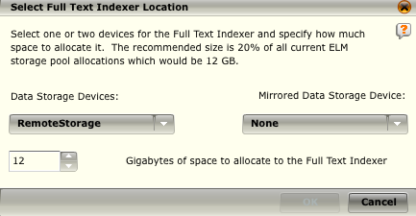
ELM Full Text Indexer
The full-text indexing engine indexes ELM logs.
When it is enabled, it provides faster ELM search speeds because it limits the number of files that need to be searched.
The number of ELM logs that can be indexed will vary based on the space you allocate for the indexer.
Notes:
Navigate to the ELM Configuration (ELM Properties > ELM Configuration) or Receiver Configuration (Receiver/ELM Properties > Receiver Configuration) window.
Click on Full Text Index. The Select Full Text Indexer Location dialog will open.
In the Data Storage Devices field, select the device that will store the full text indexer data from the drop-down list. If you select a device that is full, you will receive a warning. If necessary, you can reduce the size of existing allocations on the device to create enough room for the indexer.
In the Mirrored Data Storage Device field, select the device to mirror the full text indexer data for backup purposes.
Select the amount of space to be allocated for this data. It is recommended that this be at least 20% of the space currently allocated for all ELM storage pools on the system. The suggested space allocation will be given in the paragraph above the device fields.
Click OK to save the settings.

Slide 22
SAN Volumes
If you have a SAN card in your ELM, the volumes available on SAN storage devices can be used as storage devices for the ELM if they are properly formatted.
The system automatically detects the volumes that are available on the SAN storage device and lists them in the table on this screen.
It includes their name, which is returned by the SAN device, their size, and their current status.
There are three possible statuses:
Ready - The volume is formatted and has a recognizable file system. These volumes will appear on the list of available volumes in the SAN Volumes field on the Add Storage Device dialog where they can be selected to be used as an ELM storage device.
Formatting - The volume is in the process of being formatted and will not appear on the list of available volumes in the SAN Volumes field on the Add Storage Device dialog. To check whether formatting has been completed, click on the Refresh button. Once formatting is completed, its status will change to Ready.
Format required - The volume needs to be formatted and will not appear on the list of available volumes in the SAN Volumes field on the Add Storage Device dialog. To initiate formatting, highlight the volume and click on the Format button. Its status will change to Formatting.
Notes:
When you highlight a volume on the table, its WWPN (World Wide Port Name), protocol, universally unique identifier (UUID), and file system will be displayed in the respective fields at the bottom of the screen. Additionally, if a volume is already set up as a storage device, the Storage device field will display its storage device name. If a volume is currently in use as a storage device on the system, the Format button will be disabled because you can only format volumes that are not set up as storage on the ELM. If you need to reformat a volume so it will be usable on this system (e.g., you have been using it in another capacity on another system), highlight it on the list and click on Format.

Slide 23
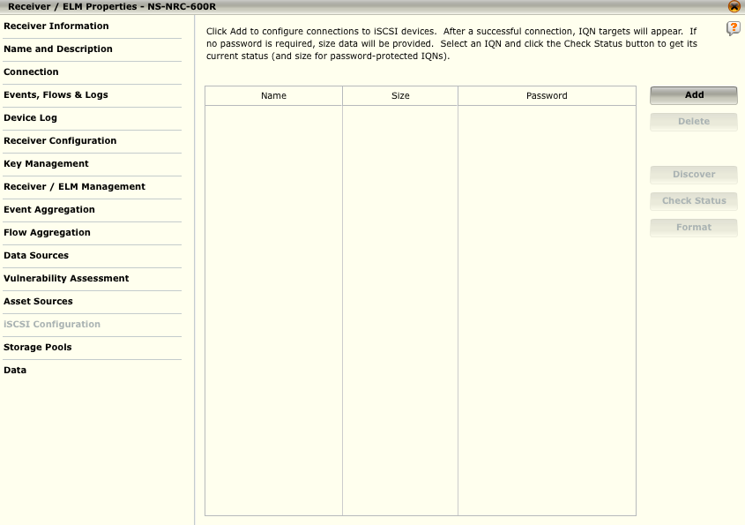
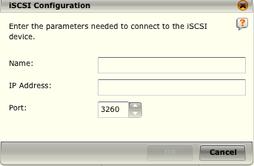
iSCSI Configuration
The iSCSI Configuration option on the ELM Properties window allows you to configure connections to iSCSI devices (or target).
WARNING
The file system used for iSCSI is not designed to allow multiple devices (IP addresses) to attach to an IQN at one time. Attempting to attach multiple devices to one IQN can cause data loss and other configuration problems.
Notes:
1. Click on iSCSI Configuration on the ELM Properties window.
2. Click Add. The iSCSI Configuration dialog opens.
3. Enter the name, IP address, and port for the iSCSI device and click OK. If the connection is successful, the device and its IQNs will be added to the list.
4. Format each IQN prior to using it as ELM storage.
Once you have set up the connection, this device will appear on the Device Type list when you are adding an ELM storage device, allowing you to select it as a storage device for ELM logs.
If the iSCSI is set up on an all-in-one ESM/Receiver/ELM, it will also appear on the Type list when you are configuring a storage location for ESM archival.
Once an IQN has begun storing ELM logs, the iSCSI target cannot be deleted. Due to this limitation, make sure to set up your iSCSI target with sufficient space for ELM storage.

Slide 24
ELM Storage Pools
Various government, industry, and corporate regulations require that logs be stored for different periods of time, depending upon the source and consumer of the logs.
In order to store logs the ELM must have access to one or more storage devices on which it can store these logs.
The storage requirement for an ELM installation is a function of the number of data sources, their logging characteristics, and their data retention time requirements.
The storage requirement will vary over time since all of these are likely to change during the life of an ELM installation.
Notes:
Important Terms:
Storage Device – A data storage device accessible to an ELM. Some ELM models offer an on-board storage device, some a SAN connection capability, and some both. All ELM models offer a NAS connection capability.
Storage Allocation – A specific amount of data storage on a specific storage device (e.g., 1TB on a NAS storage device).
Data Retention Time – The amount of time a log is stored.
Storage Pool – One or more storage allocations, which together specify a total amount of storage, coupled with a data retention time that specifies the maximum number of days a log is to be stored.
Log Source – Any source of logs that an ELM stores.

Slide 25
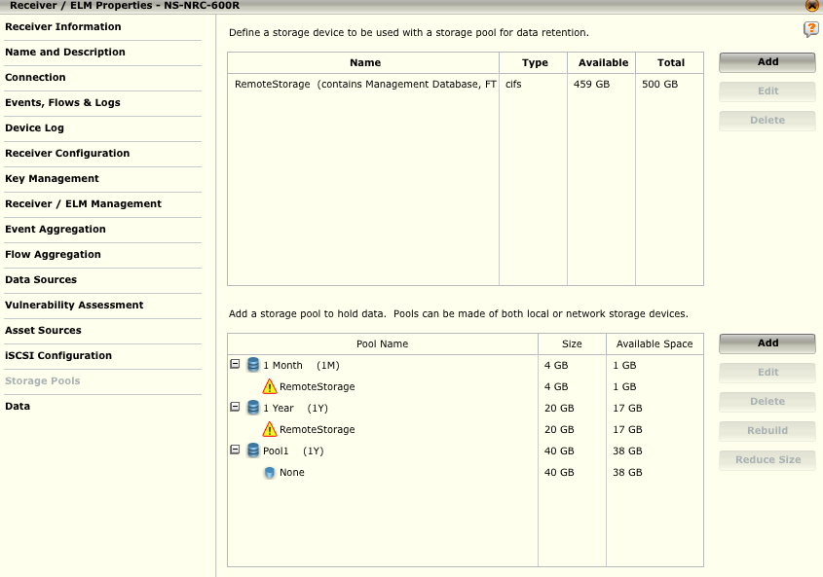
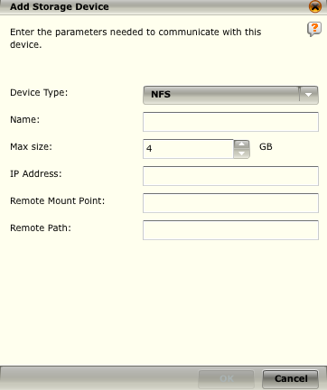
Add, Edit, or Delete a Storage Device
WARNING
The file system used for iSCSI is not designed to allow multiple devices (IP addresses) to attach to an IQN at one time. Attempting to attach multiple devices to one IQN can cause data loss and other configuration problems.
Notes:
To add a storage device that will be assigned to a storage pool, you need to define the parameters needed to communicate with this device.
1. Access the Storage Pool screen (ELM Properties > Storage Pool), which lists the existing storage devices and storage pools.
2. Click on the Add button to the right of the list of storage devices. The Add Storage Device dialog opens.
3. Select the type of storage device this is in the Device Type field. The options are CIFS, NFS, and iSCSI.
4. Type in a name for this device in the Name field.
5. Select the maximum amount of data that you want to store on this device in the Max size field.
6. Fill in the remaining fields, which will vary based on the device type selected.
• If the device type is CIFS, ensure that you do not use commas in the password field.
• If the device type is iSCSI, you will need to select the IQN in the iSCSI IQN field. Keep in mind that each IQN can only be associated with one device.
7. Click OK to save the settings. The device information will be added to the device table.
If you need to edit the parameters after they have been saved, highlight the device on the device table, click the Edit button, and make the desired changes. If you need to change the remote mount point of the storage device containing the ELM Management Database, first use the Migrate DB option to migrate the database to a different storage device (refer to the Migrate DB section). You can then safely change the remote mount point field and migrate the database to the updated storage device.
You can delete a storage device as long as it is not storing any data. To do so, select the device on the storage device table. If it is not storing data, the Delete button will become active; if it is storing data, the button will be inactive. Click on the Delete button and select Yes on the confirmation dialog that opens. There device will be deleted from the system.

Slide 26
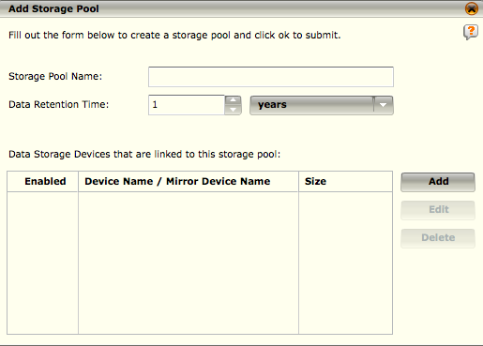
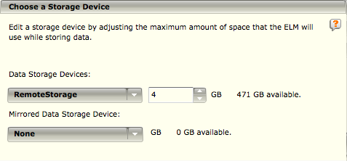
To Add, Edit, Delete a Storage Pool
Storage pool device allocations created in McAfee ESM version 9.0.0 and above will be limited to 1 terabyte per allocation.
To create a pool with more than 1 terabyte, you need to add multiple 1 terabyte devices.
Notes:
To add a storage pool to which you can assign storage devices, do the following:
1.Access the Storage Pool screen (ELM Properties > Storage Pool), which lists the existing storage devices and storage pools.
2.Click on the Add button to the right of the list of storage pools. The Add Storage Pool dialog opens.
3.Enter a name for this pool in the Storage Pool Name field.
4.Select the amount of time that you want this data to be retained in the Data Retention Time field.
5.Add the storage device(s) that will be part of this storage pool.
a. Click on the Add button to the right of the list of devices linked to this pool. The Choose a Storage Device dialog will open.
b. Click on the Data Storage Devices drop-down list and select the device to add. A device can be assigned to more than one pool at a time.
c. Select the maximum amount of storage space on this device to be used to store data. Keep in mind that 10% of the storage space will be used for overhead. In other words, if you select 4 GB in the storage space field, 3.6 GB of the 4 will actually be available to store data.
d. If you want the data on this storage device to be mirrored on a second storage device, select the second storage device in the Mirrored Data Storage Device drop-down list. For details regarding this feature, refer to the ELM Mirrored Data Storage section.
e. Click OK. The device information will be added to the table on the Add Storage Pool dialog.
7.In the Enabled column of the Data Storage Devices table, click on the checkbox(es) of the device(s) that you want to enable to store data.
8.Click OK. The pool's information will be added to the storage pool table.
Continued on next page

Slide 27
Hidden
Notes:
You can delete a storage pool as long as it, or the devices allocated to it, is not storing any data. To do so, select the pool on the storage pool table. If it or its devices are not storing data, the Delete button will become active; if it or its devices are storing data, the button will be inactive. Click on the Delete button and select Yes on the confirmation dialog that opens. The pool will be deleted from the system.
You can also delete a device so that it is no longer allocated to that pool, as long as it is not storing data for that pool. To do so, highlight the device. If it is not storing data, the Delete button will become active. Click on the Delete button and select Yes on the confirmation dialog. The device will no longer be allocated to that pool, but it will still be listed on the storage device table.

Slide 28
Rebuild a Mirrored Storage Pool
The rebuild function, which is only enabled when there is a problem with a mirrored storage pool, is used to repair mirrored storage pools that have lost connection with one of their storage devices.
This loss of connection can be caused in one of the following ways:
Failure of the file server or the network between the ELM and the file server
The file server or network is shutdown for maintenance
An allocation file is accidentally deleted.
When there is a problem with the mirror, the storage devices under each pool will show a warning icon ( ).
If you hover over the mirrored devices, a tool tip will pop up informing you that the ELM allocation is rebuilding or that the mirrored device needs to be rebuilt.
To rebuild the mirrored devices, click on the devices and click on the Rebuild button.
When the process is complete, you will be notified that the allocation rebuilt successfully.

Slide 29
ELM Mirrored Data Storage
The ELM mirrored data storage feature allows you to set up a second ELM storage device (B) to automatically mirror the data collected on the first ELM storage device (A).
If device A goes down for any reason, device B will continue storing the data as it comes in. When device A comes back on line, it automatically syncs with device B then resumes storing the data as it arrives. If device A goes down permanently, you can reassign device B to take device A's place on the ESM and then designate a different device to mirror the new device A.
When either of the devices go down, a health status flag ( )will appear next to the ELM device node on the System Navigation Tree. If you click on the flag, you will access the Device Log screen, which will inform you of the status of the ELM, including the status of its storage devices.
NOTE
If you upgrade your system from a version prior to 9.0, the first time you select to mirror any of the existing devices, the process will take an extended amount of time.
Notes:
Setting Up ELM Mirrored Data Storage
Prior to designating a device to hold ELM data, you need to add it to the list of devices available for storage. To do so, refer to the Add, Edit, or Delete a Storage Device section.
Since you are going to have two devices mirroring each other, make sure to add both devices. Once you have done so, proceed as follows:
1. Access the Storage Pools dialog (ELM Properties > Storage Pools) for the ELM device to which you will be adding this feature. The two devices you want to designate as the mirror storage devices should be listed in the Storage Device table in the top half of the dialog.
2. Click on Add to the right of the Storage Pool table in the bottom half of the dialog. The Add Storage Pool dialog will open.
3. Enter a name for this storage pool in the Storage Pool Name field.
4. Select the amount of time that you want this data to be retained. This amount must be in even numbers.
5. Click on Add to the right of the table. The Choose a Storage Device dialog will open.
6. Click on the Data Storage Devices drop-down list and select the first device. A device can be assigned to more than one pool at a time.
7. Select the maximum amount of storage space on this device to be used to store data. Keep in mind that 10% of the storage space will be used for mirroring overhead. In other words, if you select 4 GB in the storage space field, 3.6 GB of the 4 will actually be available to store data.
8. Select the second storage device in the Mirrored Data Storage Device drop-down list. Ensure that this device has at least as much storage space available as the first device.
9. Click OK. The device information will be added to the table on the Add Storage Pool dialog.
Continued on next page

Slide 30
Hidden
Notes:
Storage pool device allocations created in McAfee ESM version 9.0.0 and above will be limited to 1 terabyte per allocation. To create a pool with more than 1 terabyte, you need to add multiple 1 terabyte devices. To do so, follow Steps 5 through 9 to add the devices to the pool and enter 1000 GB in the maximum storage field (Step 7) of each of the devices. Once you have added all the storage devices needed, click on OK on the Choose a Storage Device dialog. The storage pool will be created with multiple 1 terabyte allocations totaling the required storage pool size.
Moving a Storage Pool
If you need to move a storage pool to a different device, you need to setup the device to which you want to move the pool as the mirror of the device currently holding the pool. If the storage pool to be moved is not currently mirrored, refer to the Setting Up ELM Mirrored Data Storage section to mirror the pool.
1.On the System Navigation Tree, click on the ELM device currently holding the storage pool.
2.Click on the Properties icon () on the Actions toolbar.
3.Click on the Storage Pools option.
4.Click on the mirrored devices, which will be listed under the pool to be moved, in the Storage Pool table.
5.Click on Edit to the right of the Storage Pool table in the bottom half of the dialog. The Edit Storage Device dialog will open.
6.Click on the Data Storage Devices drop-down list and select the device that has been mirroring the storage pool to be moved. It is now the data storage device.
7.If you want to have a device mirror the stored data on the new data storage device, select a device in the Mirrored Data Storage Device drop-down list. If the device you want is not listed on the drop-down list, add the device to the Storage Device table first.
8.Click OK. The new information will be added to the Storage Pool table.
Disabling a Mirroring Device
If you want to stop using a device as a storage pool mirroring device, do the following:
1.On the System Navigation Tree, click on the ELM device currently holding the storage pool.
2.Click on the Properties icon () on the Actions toolbar.
3.Click on the Storage Pools option.
4.Click on the mirrored devices, one of which you want to disable, in the Storage Pool table.
5.Click on Edit to the right of the Storage Pool table in the bottom half of the dialog. The Edit Storage Device dialog will open.
6.Do one of the following:
•If the device selected in the Mirrored Data Storage Device field is the one you need to disable, click on the drop-down arrow in that field and select a different device to mirror the data storage device or select None.
•If the device selected in the Data Storage Device field is the one you need to disable, click on the drop-down arrow in that field and select a different device to act as the data storage device.
The device is no longer being used to store a mirrored storage pool.

Slide 31
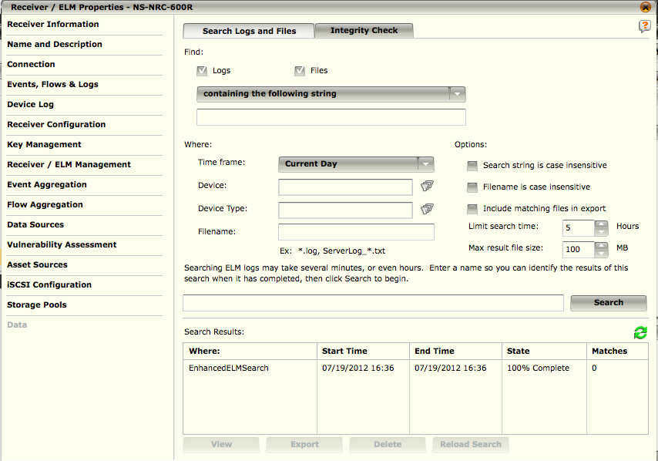
ELM Data
You will need to create search and integrity check jobs to retrieve data from the ELM.
You need to define the parameters for these jobs on the Data screen, which is accessed by selecting the Data option on the ELM Properties screen.
The system is limited to a total of 50 searches and integrity jobs at one time.
If there are more than 50 on the system, you will be informed that your search cannot be performed for this reason.
Notes:
The state of a job is displayed in the State column located at the bottom of the Data screen, and is the only notification that is given regarding the state.
The four possible states are:
Waiting - The job has not begun to process yet. The system can only process 5 jobs at a time, and it processes them in the order received.
Executing - The job is currently in progress.
Complete - The job is finished. You can view the results or download the export.
Limit Reached - The time or size limit was reached. You will be able to view results, but they will be incomplete.
The four buttons at the bottom of the Data screen perform the following actions:
View: The results for searches and integrity checks will be displayed on the ELM Search Results screen, which is accessed by clicking on the View button (see View Results section).
Export: You can export a summary of the results of the search by clicking on the Export button and selecting the download location.
Delete: To delete a search, highlight the search on the Search Results table and click on the Delete button.
Reload Search: If you want to perform the search again, click on the Reload Search button. The search parameters will be updated to match the selected search and the search can be submitted again.

Slide 32
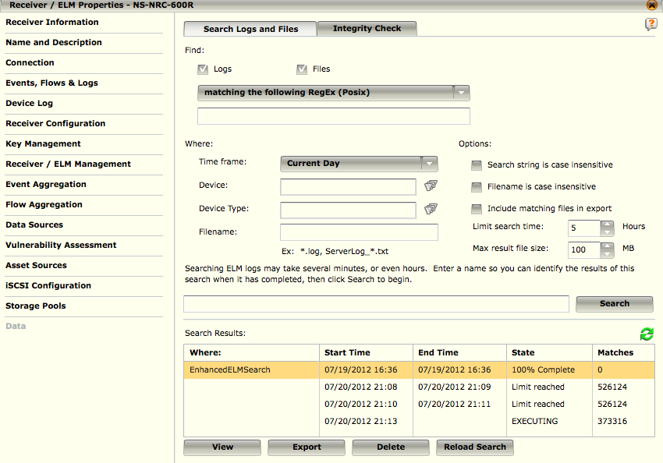
ELM Data – Create a Search Job
To search the ELM for files that match your criteria, you need to define a search job on the Data screen.
None of the fields on this screen are required; however, the better you are able to define your search, the more likely you are to retrieve the data you require in the least amount of time.
Notes:
To define your search criteria, do the following:
1. Access the Data screen (ELM Properties > Data or click on the ELM Search quick launch icon). The Search tab is selected by default.
2. Select the type(s) of files to be searched. By default, both the Data source logs and File source files will be searched. Deselect the appropriate checkbox if there is one that you do not want to search.
3. Indicate the type of search to be performed by selecting one of the following:
a. Containing the following string
b. Matching the following RegEx (Posix)
c. NOT containing the following string
d. NOT matching the following RegEx (Posix)
4. Enter the text or expression that you want the system to search for in the files that you define. If you selected option "a" or "c" in Step 3, the field should contain text. If you selected option "b" or "d" in Step 3, the field should contain an expression using the Posix format.
5. In the Where section of the screen, refine your search by doing the following, all of which are optional:
a. Select the period of time within which the data that you want to search will have been generated in the Time frame field (default is Current Day)
b. Choose the device(s) to be searched for the data you require by clicking on the folder icon to the right of the Device field. A list of the available devices on the system will appear. Select one or more devices and click on OK. The name(s) will be added to the Device field.
c. Choose the type(s) of device(s) by which you want to filter the search by clicking on the funnel icon to the right of the Device Type field. A list of the available device types on the system will open. Select the device type(s) and click on OK. The name(s) will be added to the Device Type field.
d. If you want a specific file to be searched, enter the name of the file to be searched.
Continued on next page

Slide 33
Hidden
Notes:
6. In the Options section of the screen, you can do the following:
a. Click on the Search string is case insensitive checkbox if you want the search string to not be case sensitive
b. Click on the Filename is case insensitive checkbox if the filename you entered is case insensitive
c. Indicate if you want the files that match the search criteria to be included in the search results so they can be exported. If this option is not selected, an export will only include a summary of the results of the search.
d. Depending on the breadth of the search you are defining, the search could take an extended period of time. To limit the amount of time spent on the search, select the number of hours in the Limit search time field. If you select zero (0), there will be no time limit.
e. If you want to limit the size of the result file, select the maximum number of MB in the Max result file size field.
7. Enter a descriptive name for this search in the field next to the Search button so you can identify it when it is completed.
8. Click on the Search button to initiate the search.
The job will continue to run until it is completed or it reaches one of the limits you have set, even if the Data screen is closed. You can return to this screen to check on the state of the search. When it is completed, the State column in the Search Results table will say "complete." You can then view the results, and download them if desired, by clicking on the job in the Search Results table and clicking on View. For details regarding viewing the results, see the View Results section.

Slide 34
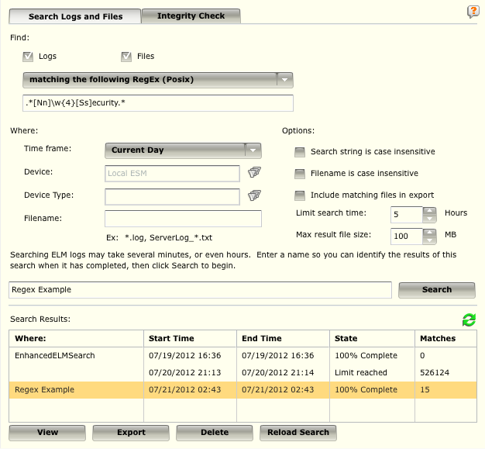
ELM Data – Create a Search Job
The state of a job is displayed in the State column located at the bottom of the Data screen, and is the only notification that is given regarding the state. The four possible states are:
Waiting - The job has not begun to process yet. The system can only process 5 jobs at a time, and it processes them in the order received.
Executing - The job is currently in progress.
Complete - The job is finished. You can view the results or download the export.
Limit Reached - The time or size limit was reached. You will be able to view results, but they will be incomplete.

Slide 35
ELM Data – Create a Search Job
The four buttons at the bottom of the Data screen perform the following actions:
View: The results for searches and integrity checks will be displayed on the ELM Search Results screen, which is accessed by clicking on the View button.
Export: You can export a summary of the results of the search by clicking on the Export button and selecting the download location.
Delete: To delete a search, highlight the search on the Search Results table and click on the Delete button.
Reload Search: If you want to perform the search again, click on the Reload Search button. The search parameters will be updated to match the selected search and the search can be submitted again.

Slide 36
ELM Data – Create a Search Job
Search Types Available:
Containing the following string
Matching the following RegEx (Posix)
NOT containing the following string
NOT matching the following RegEx (Posix)

Slide 37
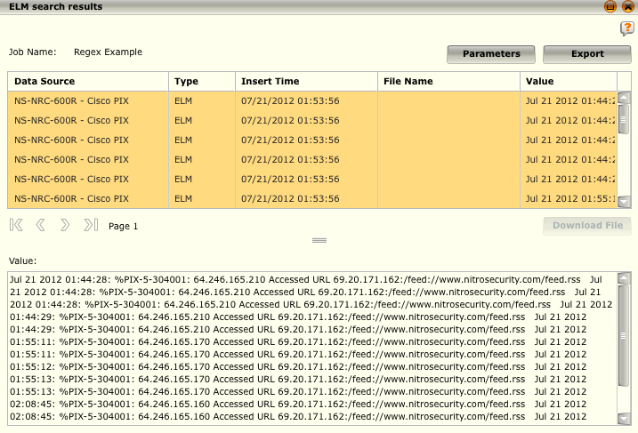
ELM Data – Create a Search Job
ELM search results can be exported using the Export button and are also visible in the Value textbox.

Slide 38
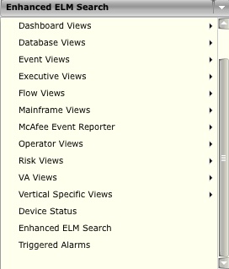

Enhanced ELM Search View
The Enhanced ELM Search view is available when there is an ELM device on the system.
It allows you to perform more detailed searches and provides you with real-time tracking of search progress and results when you are performing a search of logs on the ELM.
Additionally, the enhanced GUI takes advantage of the ELM archive's statistical reporting capabilities to provide you with real-time information about the amount of data that must be searched, allowing you to further constrain the query to minimize the number of files to be searched.
Notes:
When you select the Enhanced ELM Search option on the drop-down list of views, the Enhanced ELM Search view will open.
From here, do the following to perform a search:
If there is more than one ELM on the system, the button to the left of the text input box will have a drop-down list showing all of the ELM devices on the system. Select the ELM that you want to search.
Type in a search key in the text input box. It will accept normal text searches and regular expressions. It will not support full-text indexing vocabulary such as XOR and NOT. It will support AND and OR.
Select the time frame that the search should cover in the Time Frame drop-down list.
Select the device(s) that you want to search on the System Navigation Tree.
If desired, select one or more of the following options:
Case Insensitive - Will make the search case insensitive.
Regular Expression - Will treat the term in the search field as a regular expression.
Does NOT Contain Search Term - Will return matches that do not contain the term in the search field.
Click on Search. The search will begin and the Search button will change to a Stop button. You can then click on the Stop button to stop the search if needed.

Slide 39
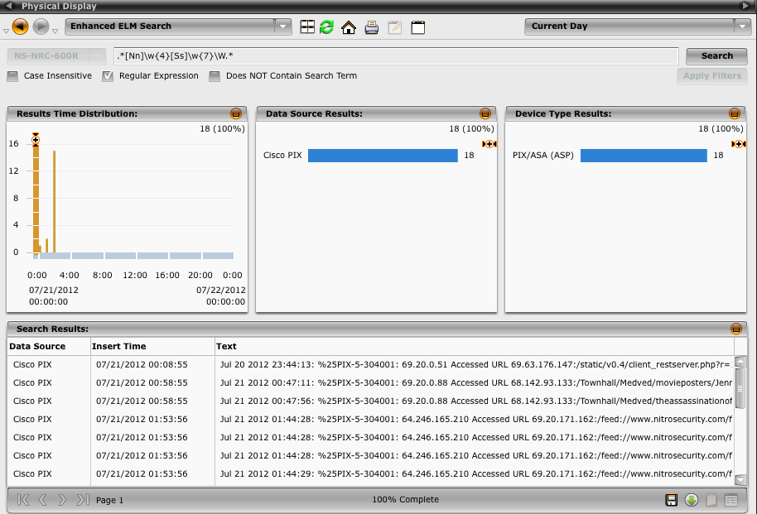
Enhanced ELM Search View
The Results Time Distribution, Data Source Results, and Device Type Results graphs show the estimated results as the search progresses
Notes:
Results Graphs
The Results Time Distribution, Data Source Results, and Device Type Results graphs show the estimated results as the search progresses. These graphs show the following:
Results Time Distribution graph - Displays the estimates and results based on a time distribution. The bottom axis changes depending on what is selected in the time frame drop-down list.
Data Source Results graph - Displays the estimates and results per data source based on the data sources of the device(s) selected in the System Navigation Tree.
Device Type Results graph - Displays the estimates and results per device type based on the device(s) selected in the System Navigation Tree.
These graphs will be populated before the searching actually begins and will be updated as results are found. If you want to narrow the search once the results have started coming in, select one or more bars on the Data Source Results or Device Type Results graphs or highlight a section of the Results Time Distribution graph then click on Apply Filters to restart the search. This allows you to drill down on the search results as well as limit the amount of data that needs to be searched. When the search is completed, these graphs will show the actual results. To zoom in on the results on the graphs, click and drag the detail enhancement icon up and down or side to side.
If you want to view the details for any of the logs in the Search Results table, click on the log and then click on the View Data Details icon in the bottom right corner.
Continued on next page

Slide 40
Hidden
Notes:
Save, Download, or Copy Search Results
As stated earlier, if you navigate away from this view without saving it, the results will be destroyed. Following are your options to avoid loosing the data:
To save the results of this search, click on the Save Search icon at anytime after the search has started and enter a name for the file in the dialog that pops up. The search will continue to run if you navigate away from the view and the results will be saved. Saved searches can be viewed on the ELM Properties > Data dialog.
To download the results, click on the Download search results file icon and designate the location to which they should be downloaded.
To copy selected items to the clipboard, select the log(s) you want to copy and click on the Copy selected items to clipboard icon. You can then paste the information into a document.

Slide 41
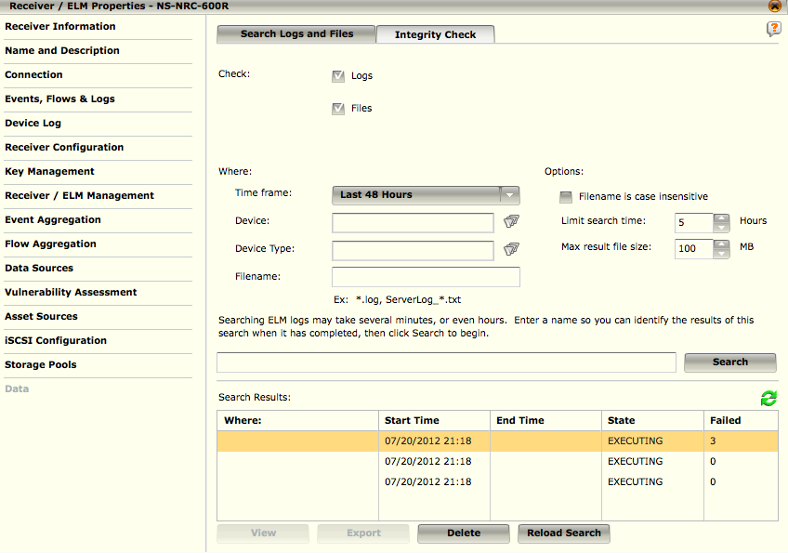
ELM Data - Create an Integrity Check Job
An integrity job checks if the files that you define have been altered since they were originally stored.
This can alert you to unauthorized modification of critical system or content files.
The results of this check will show which files have been altered. If none of the files have been altered, you will be notified that the check was successful.
Notes:
To define your criteria, do the following:
1.Access the Data screen (ELM Properties > Data or click on the ELM Search quick launch icon).
2.Click on the Integrity tab. The Integrity Check screen will open.
3.Select the type(s) of files to be searched. By default, both the Data source logs and File source files will be searched. Deselect the appropriate checkbox if there is one that you do not want to search.
4.In the Where section of the screen, define the files to be checked:
a. Select the period of time within which the data that you want to check will have been generated in the Time frame field (default is Current Day)
b. Choose the device(s) to be searched for the data you require by clicking on the folder icon to the right of the Device field. A list of the available devices on the system will appear. Select one or more devices and click on OK. The name(s) will be added to the Device field.
c. Choose the type(s) of device(s) by which you want to filter the search by clicking on the funnel icon to the right of the Device Type field. A list of the available device types on the system will open. Select the device type(s) and click on OK. The name(s) will be added to the Device Type field.
d. If you want a specific file to be checked, enter the name of the file in the Filename field.
5.In the Options section of the screen, you can do the following:
a. Click on the Filename is case insensitive checkbox if you want the filename you entered not to be case sensitive.
b. Depending on the breadth of the search you are defining, the search could take an extended period of time. To limit the amount of time spent on the search, select the number of hours in the Limit search time field. If you select zero (0), there will be no time limit.
c. If you want to limit the size of the result file, select the maximum number of MB in the Max result file size field.
Continued on next page

Slide 42
Hidden
Notes:
6.Enter a descriptive name for this check in the field next to the Search button so you can identify it when it is completed.
7.Click on the Search button to initiate the check.
The job will continue to run until it is completed or it reaches one of the limits you have set, even if the Data screen is closed. You can return to this screen to check on the state of the check. When it is completed, the State column will say "DONE." If there were no altered files, you will be notified that the search was successful. If there were altered files, you can view the results by clicking on the job in the Search Results table and clicking on View. For details regarding viewing the results, see the View Results section.

Slide 43
The amount of time a log is stored is the definition of what term?
Storage Device
Storage Allocation
Data Retention Time
Log Source
Notes:
Answer: Data Retention Time

Slide 44
As of version 9.0.0, ELM storage pools require _______ of the allocated space for mirroring overhead.
5%
10%
15%
20%
25%
30%
Notes:
Answer: 10%

Slide 45
If you need to restore the data from an old ELM to a new ELM create a new ELM using the Add Device Wizard.
True
False
Notes:
Answer: False - If you need to restore the data from an old ELM to a new ELM, do NOT create a new ELM using the Add Device Wizard.

Slide 46
The default ELM compression is set to:
Low (20:1)
High (20:1)
Medium (14:1)
Low (14:1)
Medium (10:1)
Low (10:1)
Notes:
Answer: Low (14:1)

Slide 47
The ELM system is limited to a total of 50 searches and integrity jobs at one time.
True
False
Notes:
Answer: True

